Slide 1
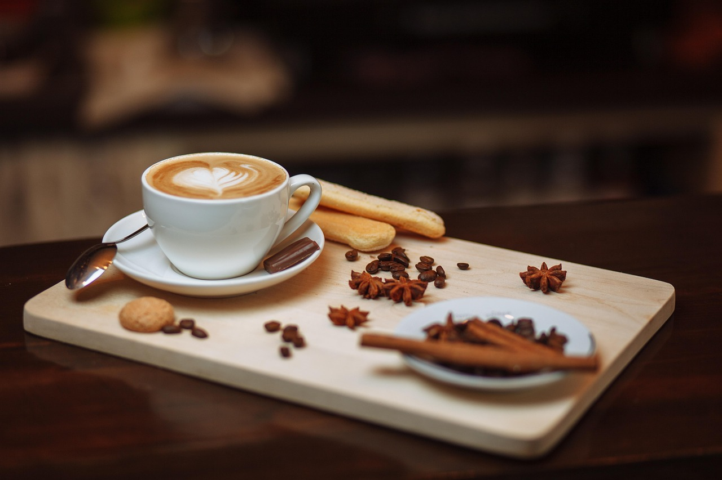
Iced Arabic Coffee Marketing Plan
Amna Al-Maraghi - 60304324
Abdulla Ahmed - 60305505
Omar ferre - 60307193
Cesar Abou Karroum - 60315574
Yousef Mohamed - 60315625
Notes:
I would like to begin by briefly presenting an executive summary of our marketing strategy. Our Iced Arabic Coffee is a product that we are launching to satisfy the increasing demand of culturally appropriate, chilled drinks in Qatar. We base our strategy on the special product offering, because Millennials and Gen Z want to receive innovative propositions, but they also appreciate traditions. We will market the cafe using social media and serve at a competitive price and experience to customers through branding and ambiance. The plan is financially sound, and we expect to break-even at the end of the first year, combined with positive KPIs suggesting profitability and scalability (6wresearch, 2025; DCunha, 2024).

Slide 2
Introduction & Market Gap
Executive summary
Iced Arabic Coffee meets demand for authentic regional flavours served in modern cold formats (Alves-Hill, 2025).
Urban lifestyles in Doha, Riyadh, and Dubai favour iced drinks over traditional hot options (DCunha, 2024).
Market gap: Lack of Arabic-style iced coffee despite a saturated premium café sector.
Notes:
In this slide, I am going to present our marketing strategy of Iced Arabic Coffee. We came across a keen market need whereby conventional Arabic flavours are lacking in cold, contemporary formats. Alves-Hill (2025) states that chilled Arabic drinks are increasingly being served in the GCC as well. The changing weather and lifestyle in urban centres such as Doha, Riyadh and Dubai has caused the preference of iced coffee (DCunha, 2024). Although there exist high-quality cafes, none of them is focused specifically on this cultural-modern mixture. Our product is the direct response to this unmet need and is the use of tradition and convenience.

Slide 3

Mission, Vision &
Corporate Values
Mission
Vision
Core Values
“To offer welcoming space and spend quality time with chilled and iced Arabic coffee”
“To offer traditional Arabic feel to coffee lovers and become a leader for Iced Arabic coffee”
Innovation, sustainability, customer satisfaction, employee centricity, and local partnerships.
Notes:
Now we will discuss mission, vision and corporate values of iced arabic coffee. Our mission is straightforward we want to provide a hospitable environment in which individuals can take iced Arabic coffee in its frozen and delicious gourmet state. The vision is not limited to coffee alone it is about having a traditional experience of Arabic, modern comfort and quality. Innovation, sustainability, and customer satisfaction are our core values determining how we package our products, training programs, and so on. An example will be choosing disposable cups made of eco-friendly bamboo and establishing collaborations with local suppliers. Such alignment contributes to not only profitability but to cultural relevancy and good moral standing so that we can also be competitive in a socially conscious market as well (Israni, 2025; Galchynska, 2023).

Slide 4
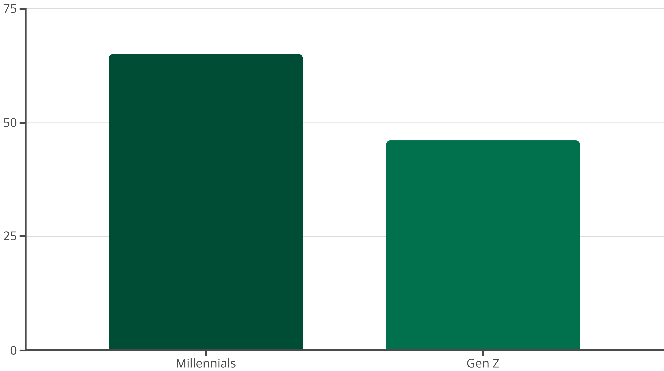
Market Opportunity & Target Segment
The Middle East café market projected to grow at 9.1% CAGR between 2023–2029 (6wresearch, 2025).
65% of Millennials and 46% of Gen Z consume coffee daily (Kyule, 2023; DCunha, 2024).
Iced Arabic Coffee serves as a cultural-modern fusion appealing to these demographics.
Notes:
In this slide we will focus on market opportunity and target segment. As The Middle East coffee market is currently thriving, as its CAGR is projected to be 9.1% between 2023 and 2029 (6wresearch, 2025). This is an indication of high prospects of new ideas such as Arabic coffee ice. A 65% and 46% of the Millennials and Gen Z (respectively) consume coffee on a daily basis (Kyule, 2023; DCunha, 2024), making them part of our target market. They also enjoy something new and cultural authenticity, so this would be the perfect target consumers of our offering. Through getting to know their lifestyles and interests we shaped a product that never was quite new but did feel different, since the product does fulfill a real market need in a changing market.

Slide 5
PESTLE Analysis Highlights
Political
Government investment in coffee culture (Hindle, 2025); VAT and instability remain threats (Al-Shboul et al., 2020).
Economic
2% GDP growth, low impact of 10.9% inflation due to strong consumer buying power (World Bank, 2024; IMF, 2025).
Sociocultural
Increasing multiculturalism and consumer desire for innovation (Corder, 2025).
Technological
Smart cafés, POS, and automation tools trending; cyber threats rising (PWC, 2024; Bowen, 2025).
Environmental
CSR, sustainability, and green consumerism valued (Israni, 2025; Kilincarslan et al., 2020).
Notes:
PESTLE is considered a tool of analysis that gives a specific overview on the market because it gives an insight of potential macro-environment factors that may influence a business. In this slide We further discuss more about our external environment with the help of a PESTLE analysis. Politically, the coffee culture is being developed with backing especially in Saudi Arabia (Hindle, 2025). However, there are threats of VAT and instability in the region (Al-Shboul et al., 2020). Economically, it is a stable region that grows by 2 percent GDP and inflation is at manageable levels (World Bank, 2024; IMF, 2025). At the sociocultural level, a move to experience-based multicultural consumption happens (Corder, 2025). On the technology front, a shift towards smart cafes and automation is becoming the norm, yet the threat of cyber-attacks is among the concerns (PWC, 2024; Bowen, 2025). Consumer-wise, ethical trends indicate that people are concerned with corporate responsibility and sustainability ( Israni, 2025).

Slide 6
Competitor Analysis
Starbucks holds 29.65% market share; Flat White gaining presence (csimarket, 2025; Faria, 2025).
Competitor
Market Share
Iced Arabic Coffee offers affordability, tradition, and sustainable packaging as USPs.
Starbucks
29.65%
Flat White
Gaining Presence
Iced Arabic Coffee
Niche Market
Emphasis on cultural branding and a distinct niche in iced Arabic coffee (flatwhite, 2025).
Notes:
As in this slide our focus is Competitor analysis. Starbucks and Flat White will be our major competitors. With a controlling market share of 29.65% (c-simarket, 2025), Starbucks is taking over, and Flat White is on its rise (Faria, 2025). The two are however geared towards Western style products. Iced Arabic Coffee offers something new, affordable, culturally rich and sustainable. The traditional Arabic interiors, ethical sourcing and biodegradable packaging will make our cafes different than the rest of the cafes in a flooded market (flatwhite 2025). Our strategic niche positioning, prevents head-to-head competition by giving us opportunity to establish a culturally connected and loyal customer base.

Slide 7
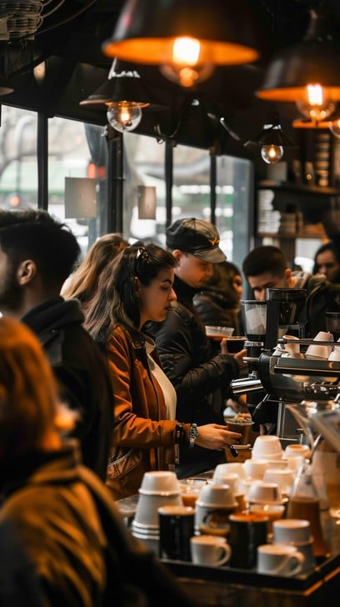
Segmentation & Buying Behaviour
Geographic
Urban Middle East
Demographic
Ages 18–50; mid-to-high income; educated
Psychographic
Café lovers, social beings, value-conscious (Changchenkit, 2024)
Behavioural
Seeking authentic iced Arabic flavours; rely on social media and word-of-mouth to explore cafés
Notes:
So in present slide we will focus on Segmentation and Buying Behaviour. Therefore, We classified our market in four lenses. In terms of geographic location, we target Qatar and other cities. Our audience is demographically aged between 18-50 years, educated and have mid to high income. Psychographically, we also have consumers who preferred social cafes and were deal-seekers (Changchenkit, 2024). In behavioural aspect, the social media and word-of-mouth influence them in the search of new cafes. They are eager to encounter culturally-based realities. Their expectations are, tradition, community, convenience under one roof, which has been offered in our brand, crossing taste to the tech-savvy service.

Slide 8
Marketing Mix (Product & Placement Strategy)
Product Range
Branding
Iced Arabic Coffee
Bamboo fibre cups
Qahwa
Soft-colour logo
Snacks
Arabic interior design (Galchynska, 2023)
Juices (Yusuf & Matiin, 2022)
Distribution: High-footfall urban areas; direct and selective distribution for quality control (Smith, 2025; Mohsen et al., 2023).
Notes:
Now We will discuss product strategy. The product is little ice Arabic coffee, although we also sell Qahwa, juices, and snacks (Yusuf & Matiin, 2022). We also intend to utilize bamboo fibre cups, light-coloured logos, and Arabic-style interiors in order to display our brand values (Galchynska, 2023). The placement strategy targets busy areas such as the workplace and college. The direct and selective distribution approaches will be employed to guarantee uniform service and keep control of quality (Smith, 2025; Mohsen et al., 2023). All the cafes will be aesthetically similar in order to build the brand loyalty and consumer confidence through every cafe.

Slide 9
Pricing strategy and competitor insights.
Regional. | Price for Small and Large | Competitor insights.
UAE (Dubai, Abu Dhabi) | AED 18–30 | Premium cafe culture; Starbucks Iced Arabic AED 28
Saudi Arabia (Riyadh, Jeddah) | SAR 15–25 | High demand for Arabic flavors; mid- to high-tier chains
Qatar (Doha) | QAR 16–28 | Sophisticated cafe scene; high disposable income
Kuwait | KWD 1.5–2.5 | Premium outlets dominate urban areas
Oman & Bahrain | OMR 1.3–2.2 ( | Competitive market, local coffee chains growing

Slide 10
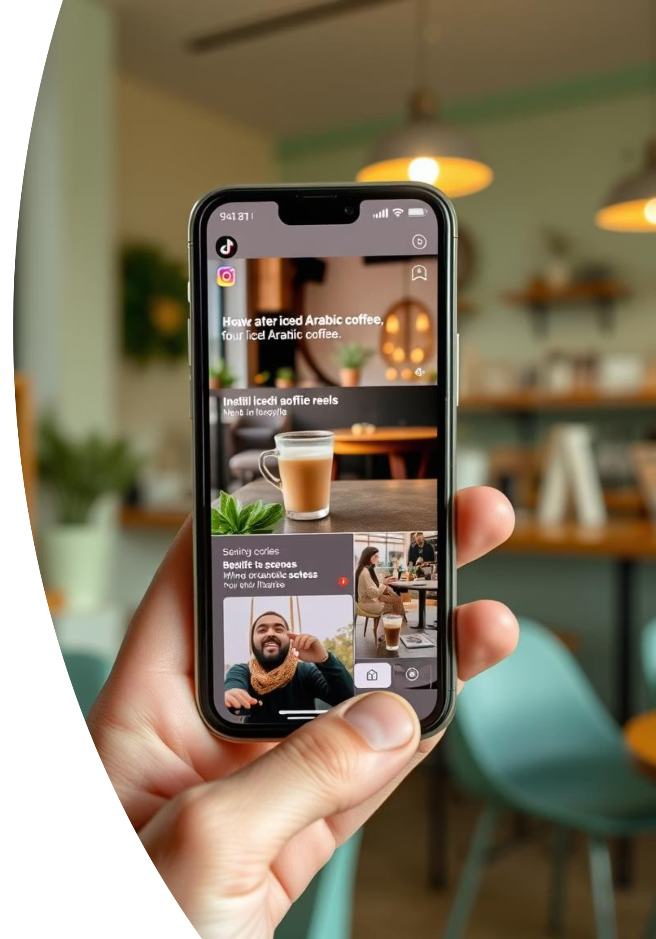
Promotion & Pricing Strategy
Promotion via TikTok, Instagram, and Facebook leveraging user behaviour of 3+ hrs/day online (McTague, 2024).
Behind-the-scenes reels of hygiene, ambience, and brewing process boost engagement.
Pricing: Competitive alignment with major players; avoids extremes to protect brand image (Ali & Anwar, 2021; Wells, 2022).
Website and content blogs to build customer loyalty and inform buying decisions.
Notes:
As our main focus is promotion and pricing of product. In this case, We will use social media Instagram, TikTok, and Facebook to get to our audience because most of our target population spends 3+ hours a day on these platforms (McTague, 2024). We will post reels depicting the atmosphere, hygiene of the kitchen, and the experience of the customers. The pricing model will be competitive in the manner of Starbucks and Flat White yet be adapted to our segment of the population (Ali & Anwar, 2021). We will also employ the use of psychological pricing options to strengthen the elite image of the café and ensure that people do not feel the strain of the pricing (Wells, 2022). The contributions to blogs and websites will assist us in making our customers enjoy and maintain them online.

Slide 11
Financial Feasibility & KPIs
1,236,288
Initial Investment (QAR)
70%
Customer Satisfaction
10%
Annual Profit Increase
100,800
Year 1 Gross Profit (QAR)
40%
ROI in Q1
15% Operational Efficiency Boost
Notes:
Present slide is about KPI’s and Financial Feasibility. Our financials are considerably feasible. We are putting in QAR 1.23 million and with regular sales; we believe that we will break-even at 497 cups/month. We are projected to generate QAR 100,800 as our first year gross profit. Tracking of performance will be done based on KPIs such as a 40 percent ROI in Q1, 10 percent increase in profit annually, and 70 percent customer satisfaction. We also target 15% effectiveness in its operations. These indicators will contribute to strategic balance, trust in the stakeholders and sustained expansions without affecting quality or ethical aspects.

Slide 12




Summary & Strategic Recommendations
Niche Capture
Blend tradition with innovation in iced Arabic coffee.
Network Expansion
Expand café network and strengthen influencer and content marketing efforts.
System Integration
Integrate smart systems, staff training, and agile feedback loops to improve sustainability and growth.
Notes:
In last Slide we provide summary and recommendations. So In conclusion, the Iced Arabic Coffee offers a unique value which is made up of culture, flavor and experience. We would recommend expanding the network of cafes to other centres of the Middle East and the strategy of influencer marketing that is to make the cafes more visible. Scalability will be adopted with technological upgrades such as smart POS systems, and real-time tracking of inventory. Constant training of employees and responding to customer comments will guarantee the process of improvement. When we brand ourselves as culturally-rich, ethical, and innovative, then we are likely to achieve success in both customer satisfaction and commercial performance.

Slide 13
References
Alves-Hill, M. (2025). Why the GCC is set to become the next big cold coffee market. hardtank. https://hardtank.com/2025/02/18/gcc-next-big-cold-coffee-market/
DCunha, S.D. (2024, Feb 19). Spilling the beans: How coffee has become big business in the Middle East. fastcompanyme. https://fastcompanyme.com/impact/spilling-the-beans-how-coffee-has-become-big-business-in-the-middle-east/
6wresearch, (2023). GCC Café and Coffee Market (2023-2029) | Share, Size, Industry, Value, Growth, Revenue, Analysis, Trends, Segmentation, Outlook & COVID-19 IMPACT. https://www.6wresearch.com/industry-report/gcc-cafe-and-coffee-market
Kyule, M. (2023, Aug 21). Millennials and Gen Z Coffee Drinkers. solaicoffee. https://www.solaicoffee.com/blog/solai-blog-2/millennials-and-gen-z-coffee-drinkers-28?srsltid=AfmBOorLMabCcP-gkxkQWwFleKIXwCjJZpafOMdyKpus8rGJXyTSe_od
Hindle, R. (2025, Apr 08). How Dubai is becoming the coffee industry’s gateway to the GCC. Coffee intelligence. https://intelligence.coffee/2025/04/dubai-is-becoming-the-gateway-to-gcc/
Al-Shboul, M., Maghyereh, A., Hassan, A., & Molyneux, P. (2020). Political risk and bank stability in the Middle East and North Africa region. Pacific-Basin Finance Journal, 60, 101291
worldbank, (2024). GDP growth (annual %) - Middle East & North Africa. https://data.worldbank.org/indicator/NY.GDP.MKTP.KD.ZG?locations=ZQ
Corder, J. (2025). The Middle East's Profound Cultural Shift. skift. https://skift.com/2024/12/10/the-middle-easts-profound-cultural-shift/
Pwc, (2024, Dec 10). Middle East's global investments drive regional eMobility and AI growth: PwC report. https://www.pwc.com/m1/en/media-centre/2024/middle-east-global-investments-drive-regional-emobility-and-ai-growth.html
Israni, S. (2025, Mar 06). 2025 Trends in the Tea & Coffee Sector in Middle East. organicandnatural. https://organicandnatural.com/2025-trends-in-the-tea-coffee-sector-in-middle-east/
imf, (2025). Inflation rate, average consumer prices. https://www.imf.org/external/datamapper/PCPIPCH@WEO/DEU/EUQ/NMQ/CMQ/APQ/AFQ/MEQ/USA
Bowen, M. (2025, May 07). Positive Technologies: 80% of cyberattacks in the Middle East result in confidential data breaches. intelligentciso. https://www.intelligentciso.com/2025/05/07/positive-technologies-80-of-cyberattacks-in-the-middle-east-result-in-confidential-data-breaches/
Kilincarslan, E., Elmagrhi, M. H., & Li, Z. (2020). Impact of governance structures on environmental disclosures in the Middle East and Africa. Corporate Governance: The international journal of business in society, 20(4), 739-763
csimarket, (2025). SBUX's Market share relative to its competitors, as of Q1 2025. https://csimarket.com/stocks/competitionSEG2.php?code=SBUX
Faria, J. (2025, May 09). Leading restaurant brands worldwide in 2025, by brand value. statista.
flatwhite, (2025). OUR STORY. https://flatwhite.qa/pages/about2-6
Changchenkit, K. (2024). FOSTERING BRAND PERSONALITY: EFFECTIVE STRATEGIES FOR CORPORATE IMPLEMENTATION. International Interdisciplinary Business Economics Advancement Journal, 5(01), 08-13.
Yusuf, M., & Matiin, N. (2022). Analysis of the effect of the marketing mix on purchasing decisions. International Journal of Economics and Management Research, 1(3), 177-182.
Galchynska, O. (2023). DESIGN THE MAIN COMPONENTS OF THE BRAND IDENTITY. Publishing House “Baltija Publishing”.
Smith, A. (2025, May 23). What Is The Marketing Mix? 4Ps & 7Ps of Marketing. meltwater. https://www.meltwater.com/en/blog/the-marketing-mix-4ps--7ps-of-marketing
Mohsen, A., Yousif, R. I., Yasser, I., & Wally, F. (2023). The Effect of Distribution Channels’ Strategies and Types On Consumers’ Buying Behavior Of Convenience Products. MSA-Management Sciences Journal, 2(2), 102-125
McTague, E. (2024, Sept 19). Social media in the Middle East: Tips for global marketers. Veracontent. https://veracontent.com/mix/social-media-middle-east/
Ali, B. J., & Anwar, G. (2021). Marketing Strategy: Pricing strategies and its influence on consumer purchasing decision. Ali, BJ, & Anwar, G.(2021). Marketing Strategy: Pricing strategies and its influence on consumer purchasing decision. International journal of Rural Development, Environment and Health Research, 5(2), 26-39.
Wells, T. (2022, Mar 15). Importance Of Pricing Strategy in Preventing High Price Sensitivity. taylorwells. https://taylorwells.com.au/importance-of-pricing-strategy/

